Slide 1
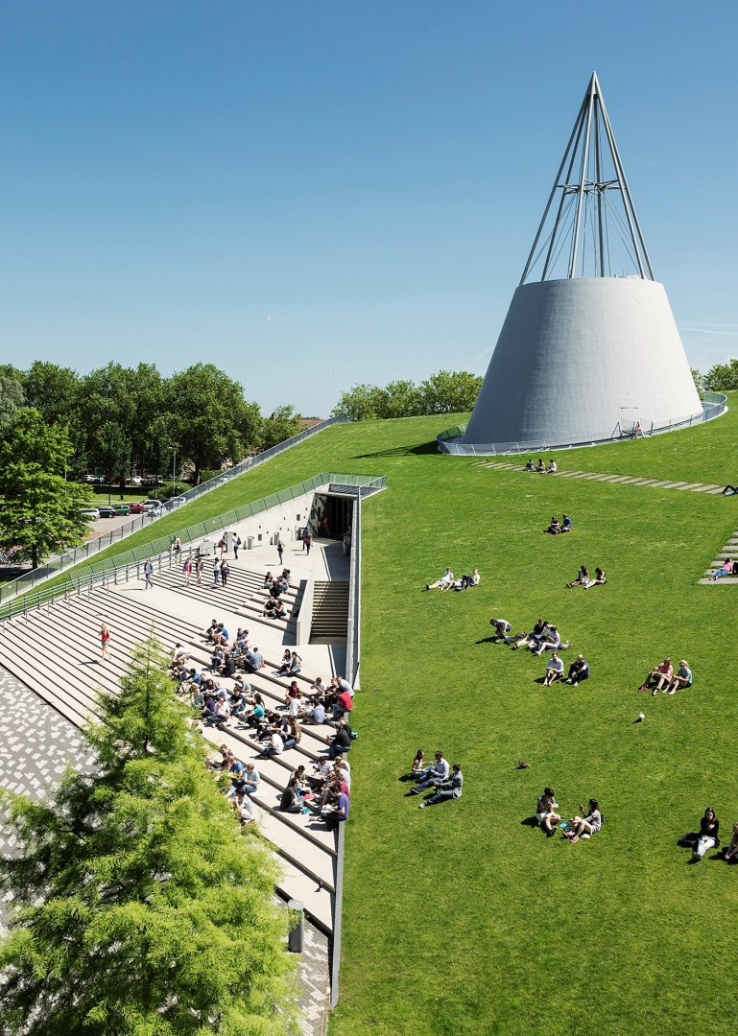
Title slide + image
Modelling plans
Group 29

Slide 2
Agenda | 5x
Create/edit a Hyperlink TO A SLIDE
1
Go to the tab ‘Insert’ and click on the button ‘Shapes’. Choose the shape ‘Rectangle’ and drag the mouse over the slide to create a shape.
Shapes
2
Drag the shape over the menu button and scale the shape as large as the button. Click with the right mouse button on the shape and choose ‘Edit shape’.
Size and position…
Edit shape…
3
Click on the paint bucket icon, click on ‘Shape Fill’ and drag the ‘Transparency’ slider to 100%. Now the shape is completely transparent.
01
02
03
04
05
Baseline model description
Functionalities baseline model
Extended model description
Functionalities extended model
Questions
Transparency
100%
4
Click on the transparent shape and use the shortcut Ctrl + K to add a hyperlink. At the left side of the window, click on ‘Place in this document’ and select the preferred slide in the list. Then click on ‘OK’.
5
Copy the transparent shape and repeat step 4. Do this for all menu buttons.
Want to know more? Go to the tab 'SLIDEBUILDER’ and click on the button ‘Inspiration'
Inspiration

Slide 3
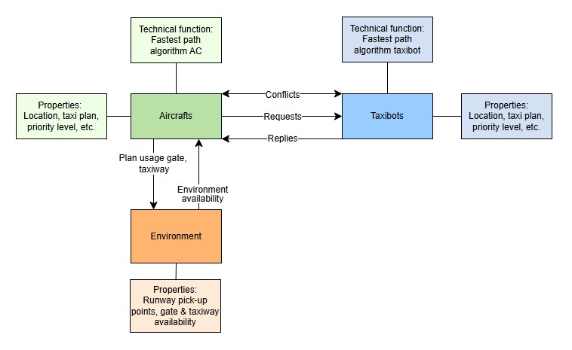
Baseline model

Slide 4
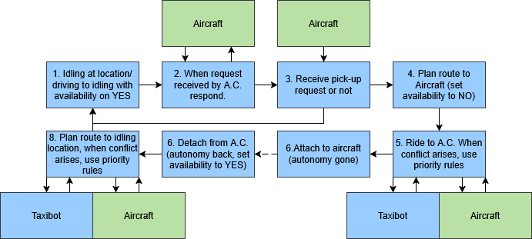
Baseline model – functionalities taxibot
Single_agent_planner
Calculates the fastest path using a star
Uses build_constraint_table to set nodes to prohibited (tutorial)
Determine_prioritylevel
From inputs routelength, delay, movement_options and pickup status, a priority level is determined
Conflict_detector (is in run_me.py)
Looks in node planning dictonairy, which constains x nodes ahead for each agent, whether a conflict will arise.
Starts conflict resolution function
4. Conflict_resolver
Uses determine_priority_level
Sends priority level to other agent involved
Sets constraint (if priority level is lower than other agent)
Initiates new Astar planning

Slide 5
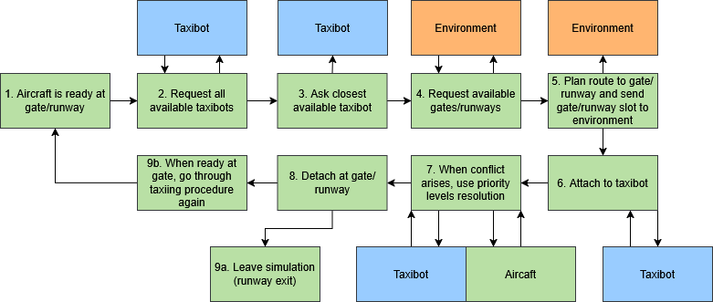
Baseline model – functionalites aircraft
All functions of taxibot
Request_taxibot
When arrives (gate or runway) request availabilities
Use heuristic to find shortest path and choose that taxibot
Set that taxibots goal
To its location

Slide 6
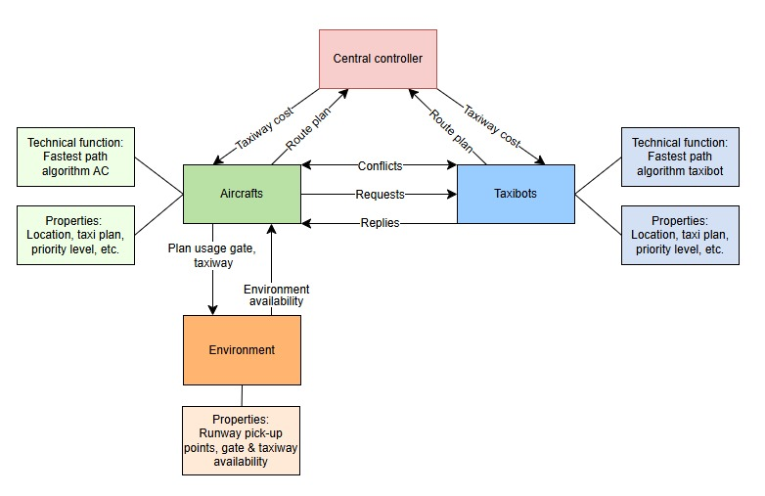
Extended model

Slide 7
Baseline model – functionalites central controller
Gather all paths of all agents
Determine busy choke points
Set cost to drive over choke point higher (calibrate when necessary)

Slide 8

Chapter | dark mode
Questions

Slide 9
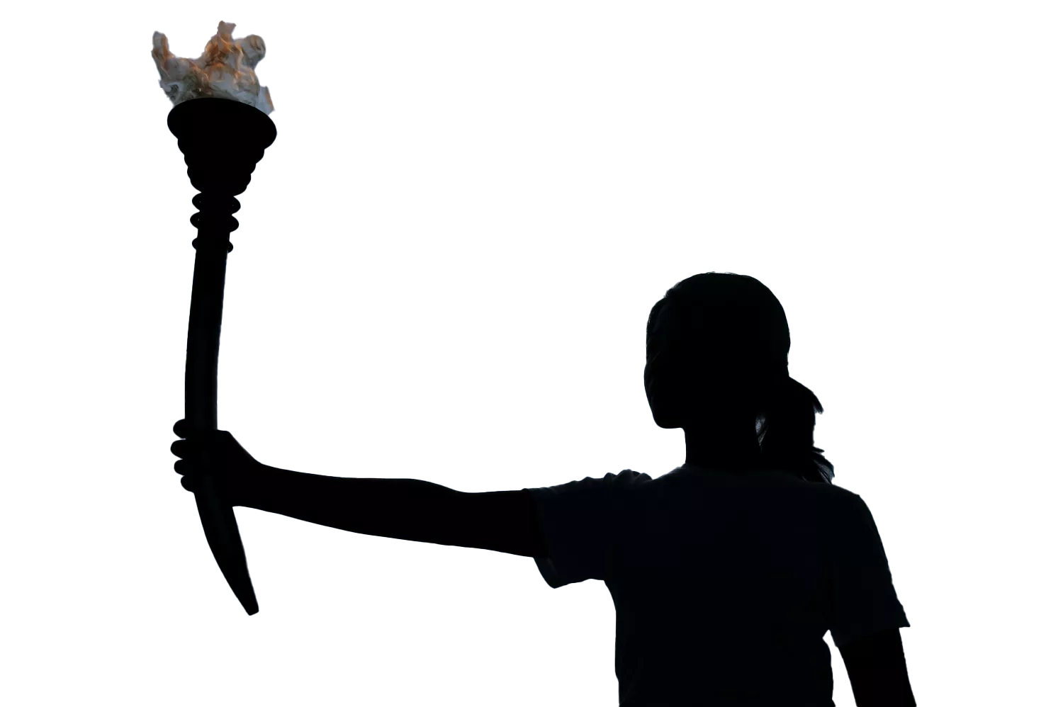


Quote
The fire of Prometheus
Notes:
The TU Delft logo features a flame above the "T" in "TU Delft". The flame and letter together form a burning torch. This is a reference to the fire of Prometheus, a figure from Greek myth who stole the fire from the gods and gave it to the people. Prometheus taught humanity how to use fire to work metal. As a result, he is known as the very first teacher of technology.

Slide 10
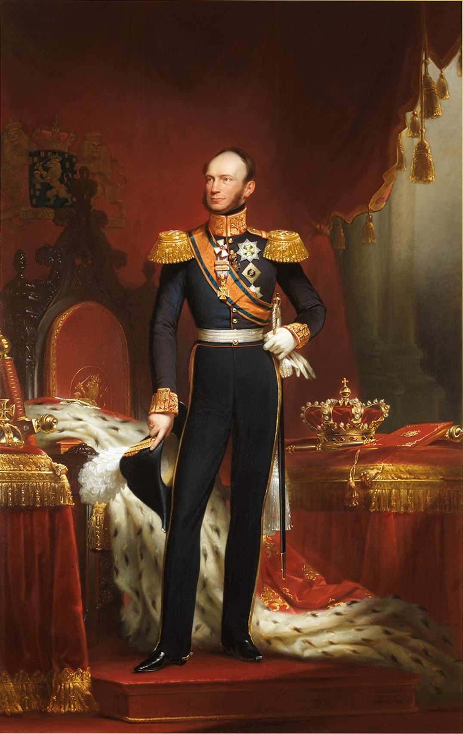
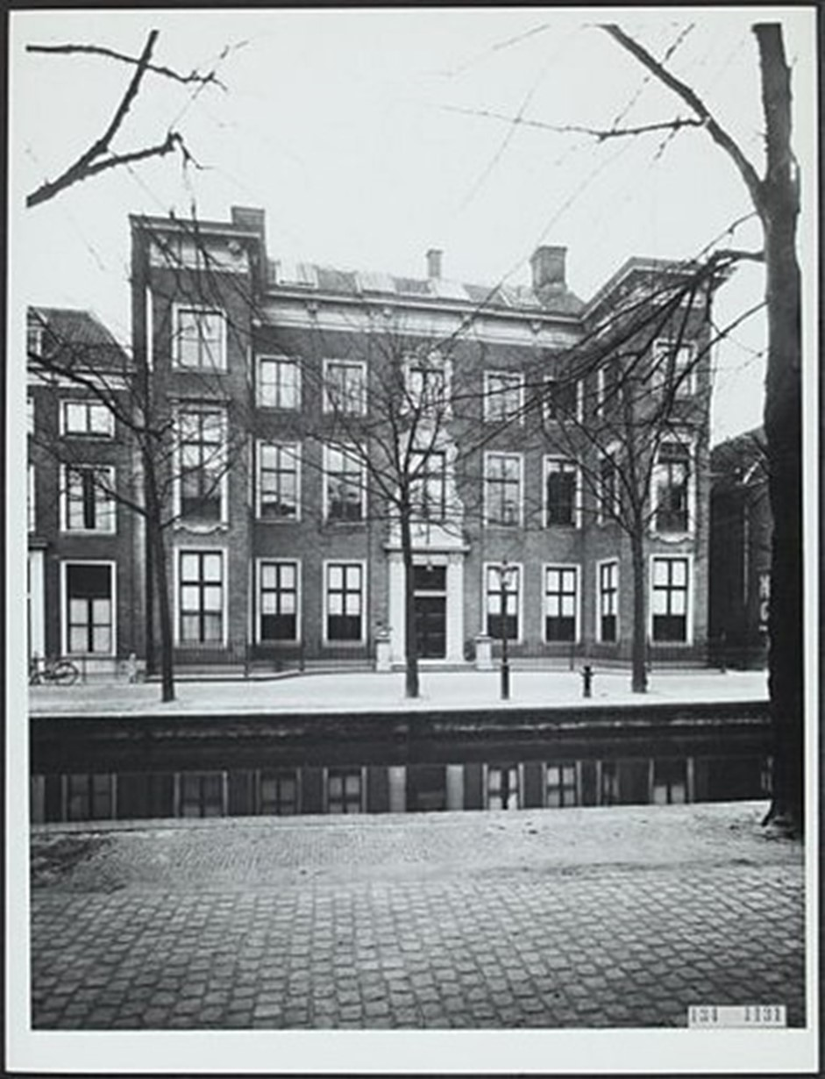
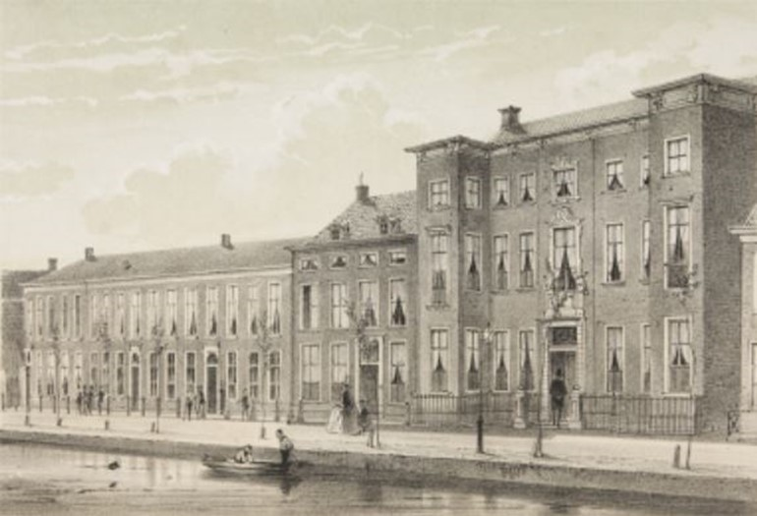
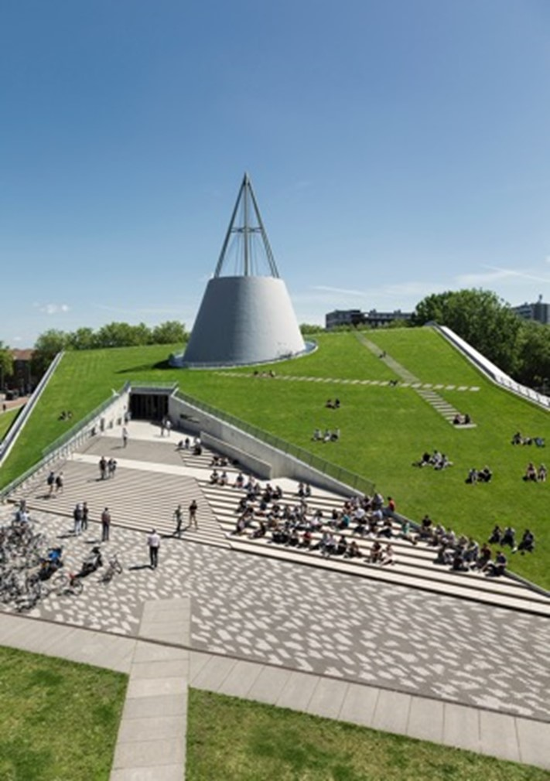
History
Polytechnic School
TU Delft
1864-1905
1986-NOW
1842-1864
1905-1986
Royal Academy
Delft Institute of Technology
Notes:
1842-1864: Royal Academy On 8 January 1842, King William II established the 'Royal Academy for the education of civilian engineers, for serving both nation and industry, and of apprentices for trade'. The Academy also trained civil servants for the colonies and tax officials for the Dutch East Indies.
1864-1905: Polytechnic School On 2 May 1863, a law was enacted establishing the rules for technical education, bringing it under the influence of the rules that applied for secondary education. Later, on 20 June 1864, the Delft Royal Academy was disbanded by Royal Decree in order to make way for a new ‘Polytechnic School’. It began training architects and engineers in civil engineering, shipbuilding, mechanical engineering and mining.
1905-1986: Delft Institute of Technology On 22 May 1905, a law was enacted that recognised the academic level of the technical education offered by the Polytechnic School and it became a Technical College, or Institute for Technology. Queen Wilhelmina attended the official opening on 10 July 1905. The Institute’s first Rector Magnificus was the professor of hydraulic engineering, ir. J. Kraus.
1986-present: Delft University of Technology In accordance with a law enacted on 1 September 1986, the Institute officially became Delft University of Technology, abbreviated to TU Delft.

Slide 11
Chapter | dark mode
02
Impact for a better society
TU Delft

Slide 12


Chapter | dark mode
TU Delft: 'Impact for a better society’
Impact for a better society
Global challenges: climate, energy transition, urban growth, digital society, health
TU Delft
Notes:
Strategy https://www.tudelft.nl/en/about-tu-delft/strategy

Slide 13




Chapter | dark mode
Delft approach: solid, hands-on, pragmatic, innovative, with courage, out-of-the-box and socially involved
Impact for a better society
Multidisciplinary approach with diverse perspectives and interests
Future-proof solutions
TU Delft
Collaboration with partners
Notes:
Strategy https://www.tudelft.nl/en/about-tu-delft/strategy

Slide 14



Chapter | dark mode
Ambitious commitment to positive change
Impact for a better society
World-class in research, education and innovation
TU Delft
Focus on the big social issues
of this century.
Notes:
Strategy https://www.tudelft.nl/en/about-tu-delft/strategy

Slide 15

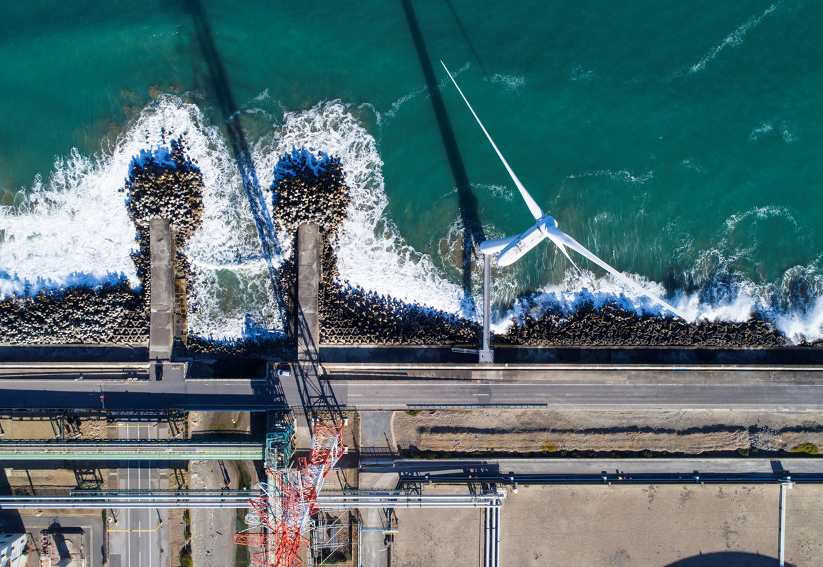
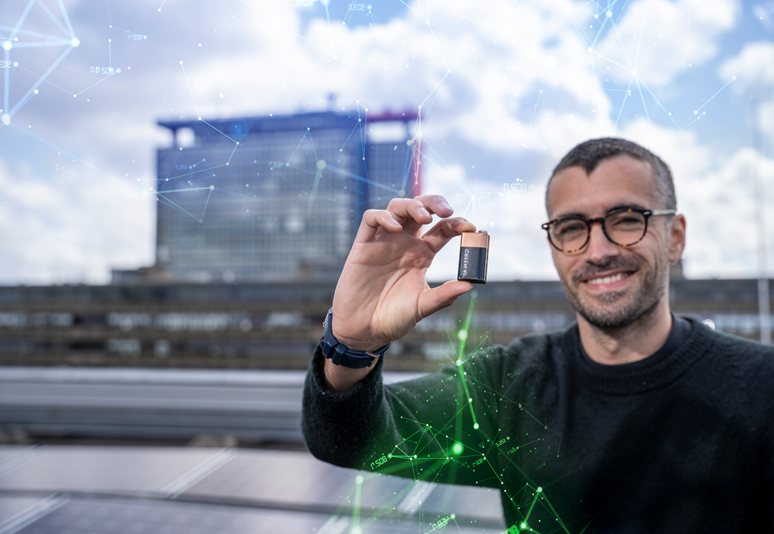
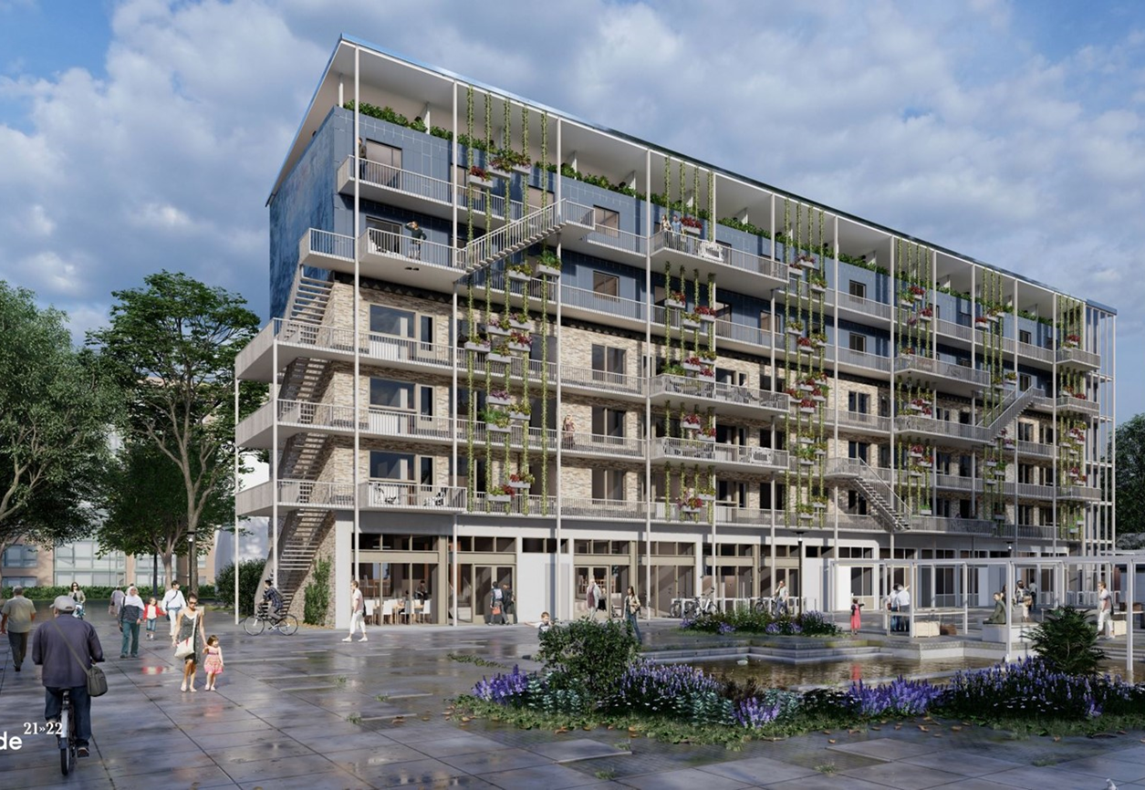

4 societal themes
Health
Climate & Energy
Digital Society
Resilient Cities & Mobility
Notes:
General slide about the 4 themes. The following slides can be “unhidden” to elaborate on themes if needed.

Slide 16
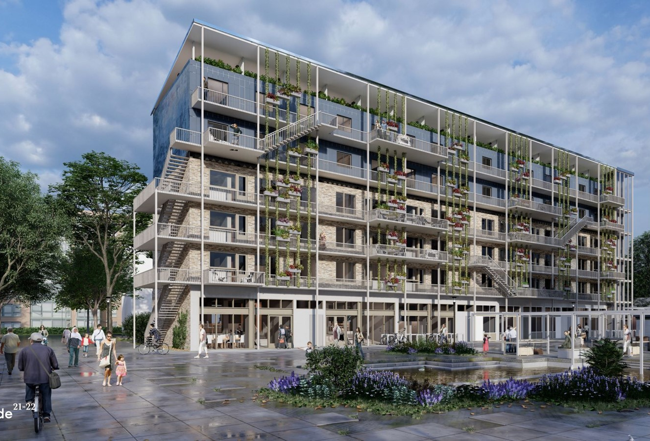

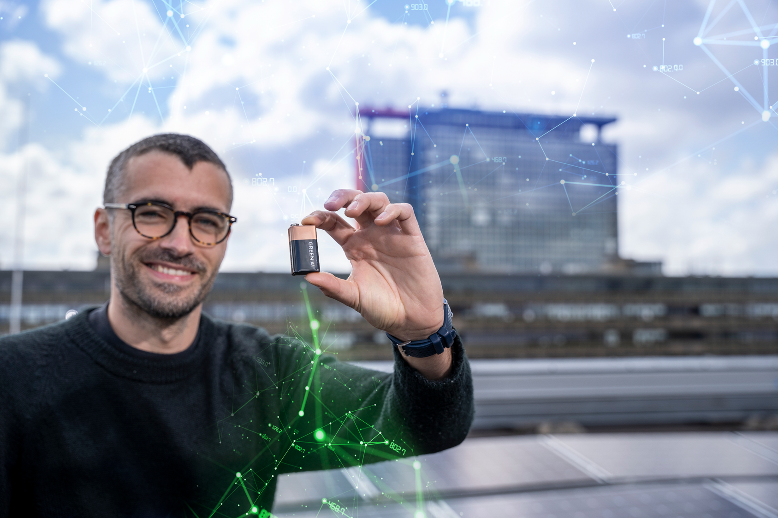
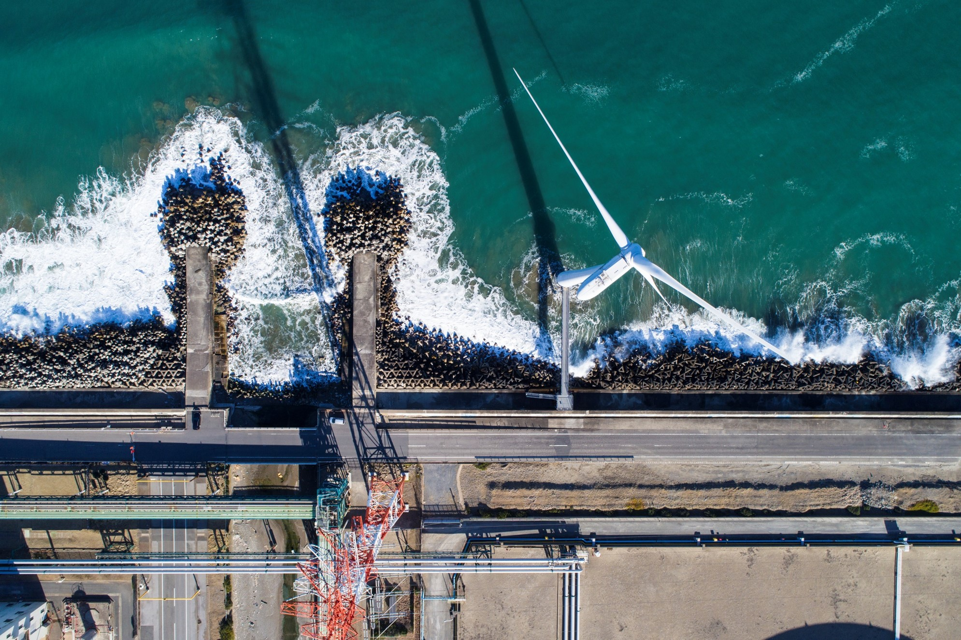

Quote
Health
Climate & Energy
Health care transformation: towards a resilient, inclusive and affordable system. Topics: digitalization, future of work in healthcare & prevention.
Climate change is a worldwide phenomenon. We prepare for the risks and work on innovations which will stop its devastating course, both regionally and across the world.
Unique 'TUD way' in the health domain: combination of disciplines engineering-science-design & health ecosystem (Rotterdam region/convergence).
We pool the knowledge needed to create a better understanding of climate and work on a faster energy transition.
Circularity in healthcare system. Topics: recycable, reusable surgical instruments and affordable & sustainable tools.
TU Delft aims to be operating in a completely sustainable manner. All activities on and from the campus will then be carbon neutral, circular, climate adaptive and contributing to the quality of life for its users and for nature.
Notes:
Kijk voor updates op: https://www.tudelft.nl/onze-maatschappelijke-uitdagingen en Engelse: https://www.tudelft.nl/en/our-societal-challenges

Slide 17
Quote
Health
Digital Society
Climate & Energy
Health care transformation: towards a resilient, inclusive and affordable system. Topics: digitalization, future of work in healthcare & prevention
Climate change is a worldwide phenomenon. We prepare for the risks and work on innovations which will stop its devastating course, both regionally and across the world.
AI & algorithms: just, responsible and inclusive
Precision Medicine. Topics: neurotech, nanotechnologies, medical implants, imaging technologies, sensors
We pool the knowledge needed to create a better understanding of climate and work on a faster energy transition.
Chips & hardware: energy and material efficient
Circularity in /of healthcare system. Topics: recycable, reusable surgical tools and affordable & sustainable devices
TU Delft aims to be operating in a completely sustainable manner by 2030. All activities on and from the campus will then be carbon neutral, circular, climate adaptive and contribute to the quality of life for her users and for nature.
Drones & robotics: human-centered development
Notes:
Kijk voor updates op: https://www.tudelft.nl/onze-maatschappelijke-uitdagingen en Engelse: https://www.tudelft.nl/en/our-societal-challenges

Slide 18
Quote
Digital Society
We are in a new digital society. But how do we design them as responsibly, inclusively, sustainably and safely as possible?
Our research, education and innovation in this area includes fundamental technologies, such as AI, Quantum, Microelectronics, Robotics, Drones & Cybersecurity.
At TU Delft, wedont just invent and design these digital technologies. We actually work with them ourselves, with a strong emphasis on their social applications. In the Netherlands and across Europe.
Notes:
Begeleidende tekst voor in notes:
AI & algorithms: just, responsible and inclusive. Ai is already all around us. At TU Delft we develop AI and work with AI to develop new engineering technologies and innovations. We have to make sure that we design and manage this responsibly, inclusive and sustainable.
Chips & hardware: with the integration of chips and connectivity in almost all aspects of our society, development of sustainable chips and hardware is crucial. A special mention should be made of our efforts surrounding quantum computing and quantum internet through our collaboration with TNO in QuTech.
Drones & robotics: the future of work will be a collaboration between humans and robots, drones and different forms of (embodied) AI. How do we make sure we develop this technology with a focus on improving quality of life for us humans, users and society in general?
Kijk voor updates op: https://www.tudelft.nl/onze-maatschappelijke-uitdagingen en Engelse: https://www.tudelft.nl/en/our-societal-challenges

Slide 19
Quote
Digital Society
Resilient Cities & Mobility
AI & algorithms: just, responsible and inclusive
Climate change, population growth and increasing inequality are pushing cities and infrastructure to breaking point.
Chips & hardware: energy and material efficient
Our research and innovation help to engineer resilient cities and to make urban mobility smart and sustainable.
Drones & robotics: human-centered development
In partnership with government agencies, businesses and citizens we research and develop technological solutions and test and implement groundbreaking innovations in buildings, on roads, in cities and in the air.
Notes:
Op de foto zie je een project van een groot studententeam waarmee zij deelnamen aan de Solar Decathlon. Zij hebben een oplossing ontwikkeld voor de 847.000 verouderde portiekflats in Nederland. SUM wil deze flats transformeren met een ‘energiepositieve optopping’: een module die niet alleen twee nieuwe lagen met extra woningen creëert, maar de flat óók energieneutraal maakt. Hiermee wordt een belangrijke bijdrage geleverd aan de uitdaging om in tien jaar één miljoen woningen te creëren en een groot deel van de bestaande voorraad te verduurzamen.
Kijk voor updates op: https://www.tudelft.nl/onze-maatschappelijke-uitdagingen en Engelse: https://www.tudelft.nl/en/our-societal-challenges

Slide 20
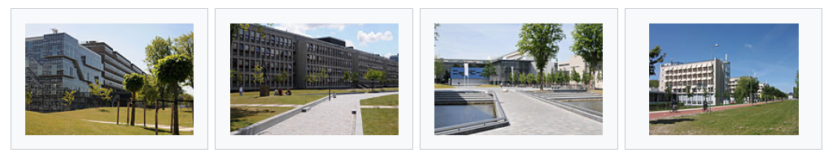
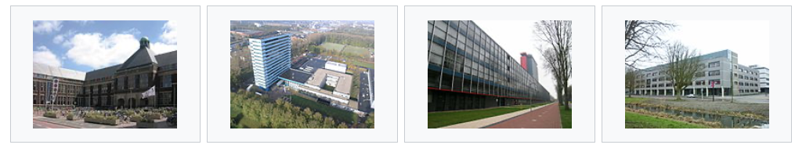
8 faculties: 16 Bsc, 38 MSc and 11 post-graduate programs
CEG
Civil Engineering and Geosciences
AS
Applied Sciences
IDE
Industrial Design Engineering
ME
Mechanical Engineering
BK
Architecture and the Built Enviroment
AE
Aerospace Engineering
EEMCS
Electrical Engineering Mathematics & Computer Science
TPM
Technology, Policy and Management

Slide 21
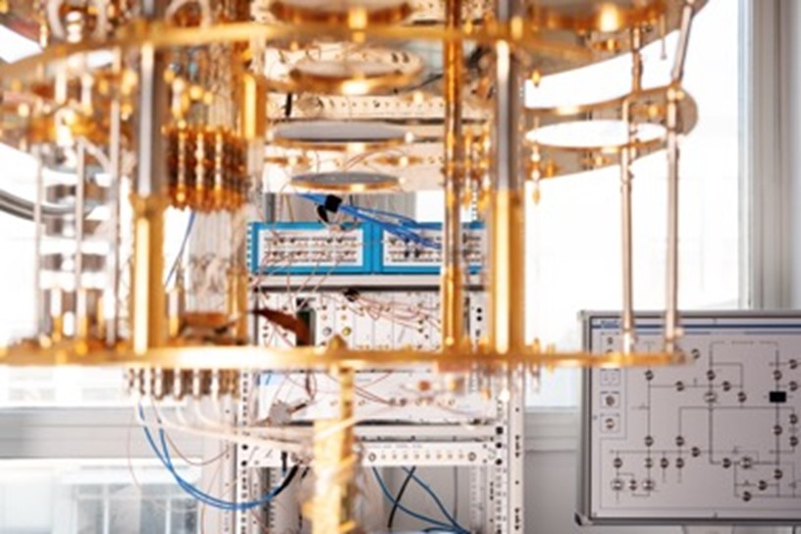
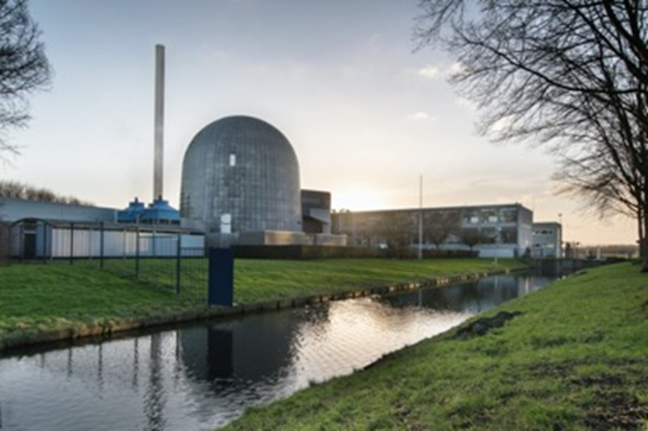
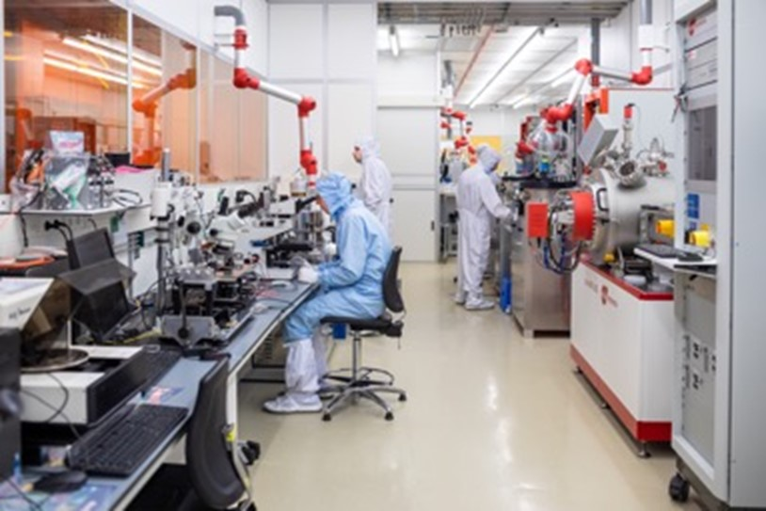
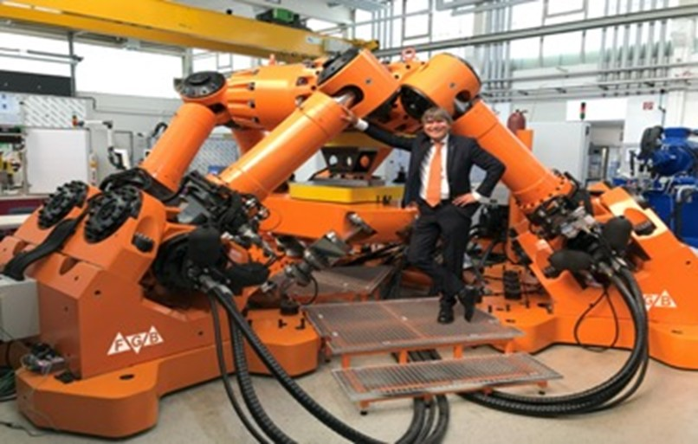
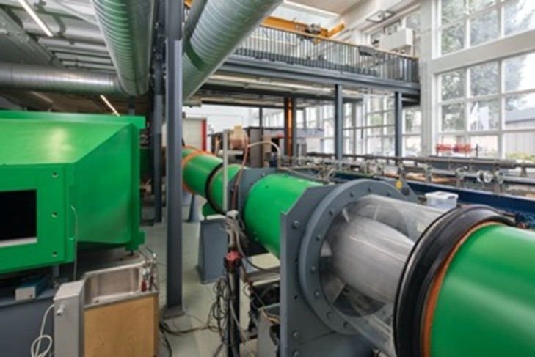
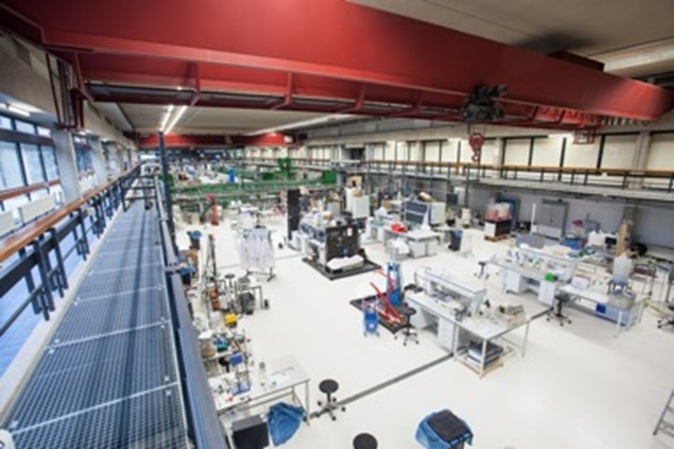
Research facilities
QuTech
Reactor Insitute
Labs
Hexapod
Wind tunnel
WaterLab

Slide 22

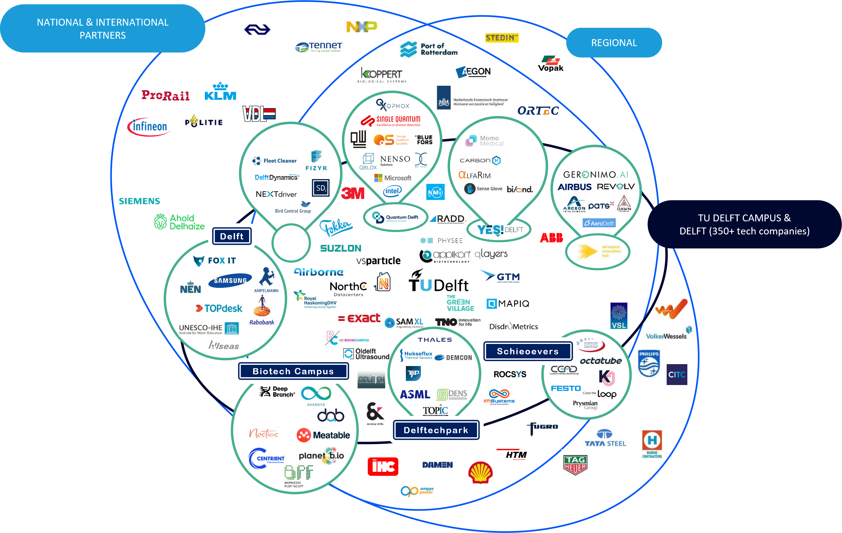
Broad cooperation

Slide 23
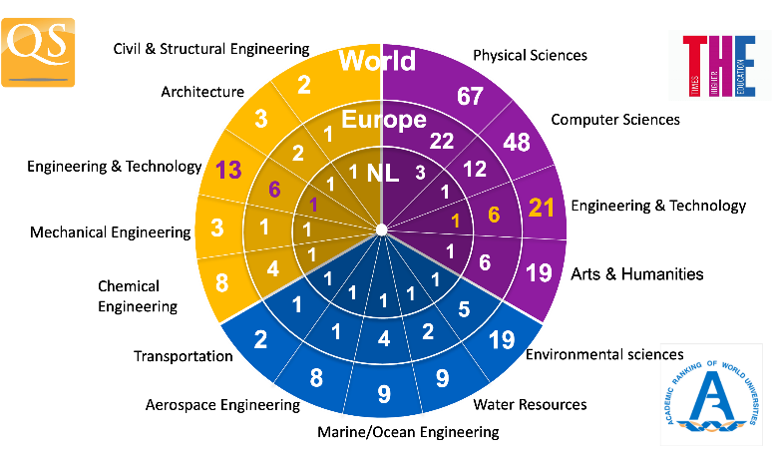
Strong international position
2023
Notes:
For the most recent insights: https://www.tudelft.nl/en/about-tu-delft/facts-and-figures/tu-delft-in-international-rankings

Slide 24
Chapter | dark mode
03
Organisation & Figures
TU Delft

Slide 25
TU Delft Organisation
Ministry of Education, Culture and Science
Works Council
Supervisory Board
Operational Committee
Student Council
Executive Board
Board for Doctorates
Local Consultation
Board of Professors
Secretary General
University Corporate Office
Strategic Development (SD)
Legal Services (LS)
Communication (Com)
Education & Student Affairs (ESA)
Human Resources (HR)
ICT (ICT)
Finance (Fin)
Campus Real Estate & Facility Management (CREFM)
TU Delft Library (Lib)
Electronic & Mechanical Support (EMS)
Programme directorate
Innovation & Impact Centre (IIC)
Extension School for Continuing
Education
Faculties
Architecture and the Built Environment (ABE)
Civil Engineering and Geosciences (CEG)
Electrical Engineering, Mathematics and Computer Science (EEMCS)
Industrial Design Engineering (IDE)
Aerospace Engineering (AE)
Technology, Policy and Management (TPM)
Applied Sciences (AS)
Mechanical Engineering (ME)
Graduate School
QuTech
TU Delft Holdings
Notes:
Organogram: https://www.tudelft.nl/en/about-tu-delft/organisation

Slide 26

26.417
3.325
7.128
Students | Dec-23
PHD population | Dec-23
BSC/MSC degrees | Dec-23
408
7.267
4.389
PHD defences | Dec-23
Staff | Dec-23
Publications | Dec-23
Notes:
Recent figures: https://www.tudelft.nl/en/about-tu-delft/facts-and-figures

Slide 27

Online education for lifelong learning
3.7 Million registered users and counting
Hundreds of courses and short programs
Learner-centred and highly applicable
Broadening the skillset and supporting career paths
Notes:
Since 2013, the Extension School for Continuing Education is the entity responsible for realizing our university’s contribution to life long learning and post-higher education training and development. The recipient of several prestigious awards as leader in online education, it works with TU Delft faculties and external partners to develop and deliver online courses and programs to equip people to solve today’s global challenges.
The key focus is delivering expert knowledge and applicable skills for lifelong learners and working professionals. By combining TU Delft’s academic knowledge with advanced learning methods and tools, our online courses and short programs help learners at various stages of their professional life – to stay on top of their game – whether they are looking to change career, broaden their skillset, or acquire further academic qualifications.
https://www.tudelft.nl/extensionschool

Slide 28
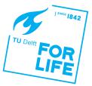

Alumini
Germany 3,424
Alumni 2023
Top 10 companies & countries
Netherlands 100,749
Belgium 2,186
USA 3,800
ASML | 1,414
Shell | 1,109
TNO | 847
Royal Haskoning | 754
Rijkswaterstaat | 806
Van Oord | 450
Phillips | 416
Deloitte | 335
Deltares | 309
Rabobank | 288
United Kingdom
2,645
France 1,472
Italy 1,820
China 1,773
Spain 2,134
Switzerland 1,641
Notes:
Source: LinkedIn Sep-23

Slide 29
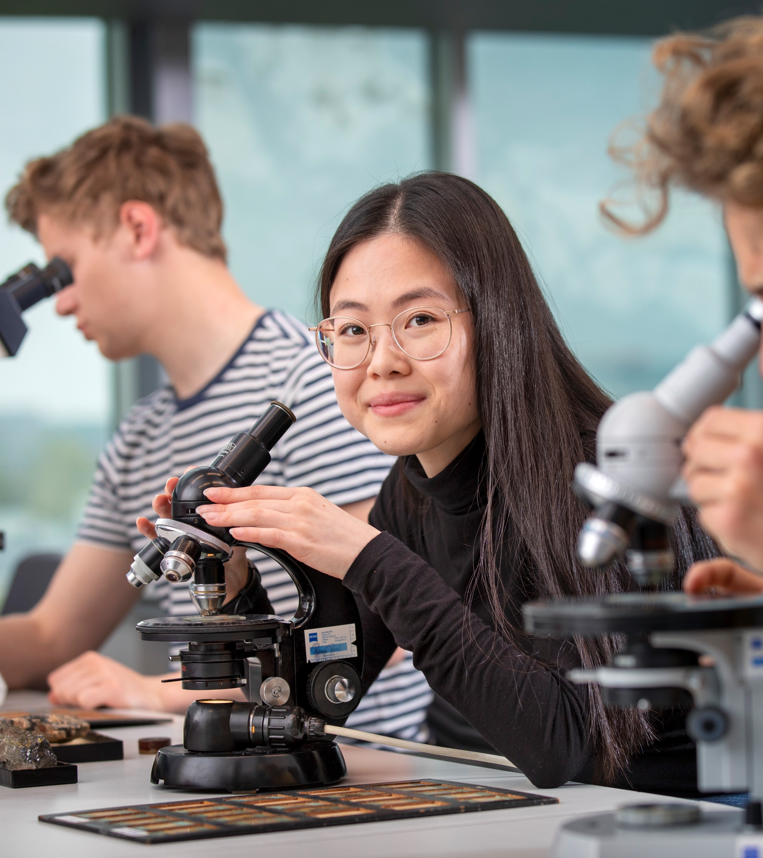

Want to know more about Alumni?
Please contact us via alumnirelations@tudelft.nl or visit www.tudelft.nl/alumni
Notes:
www.tudelft.nl/alumni

Slide 30
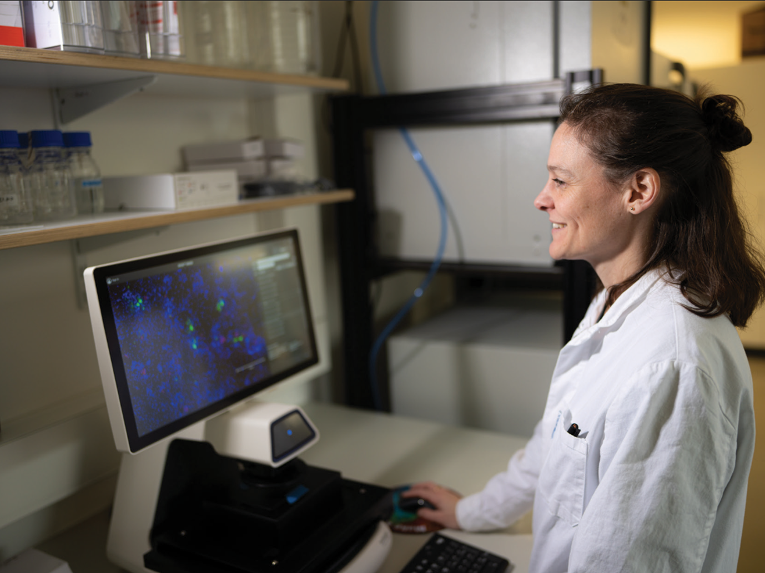
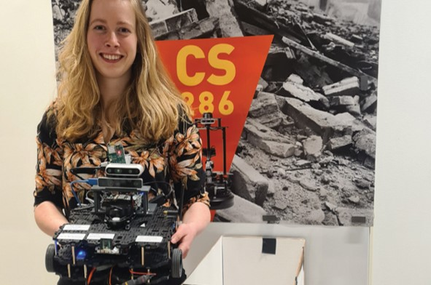
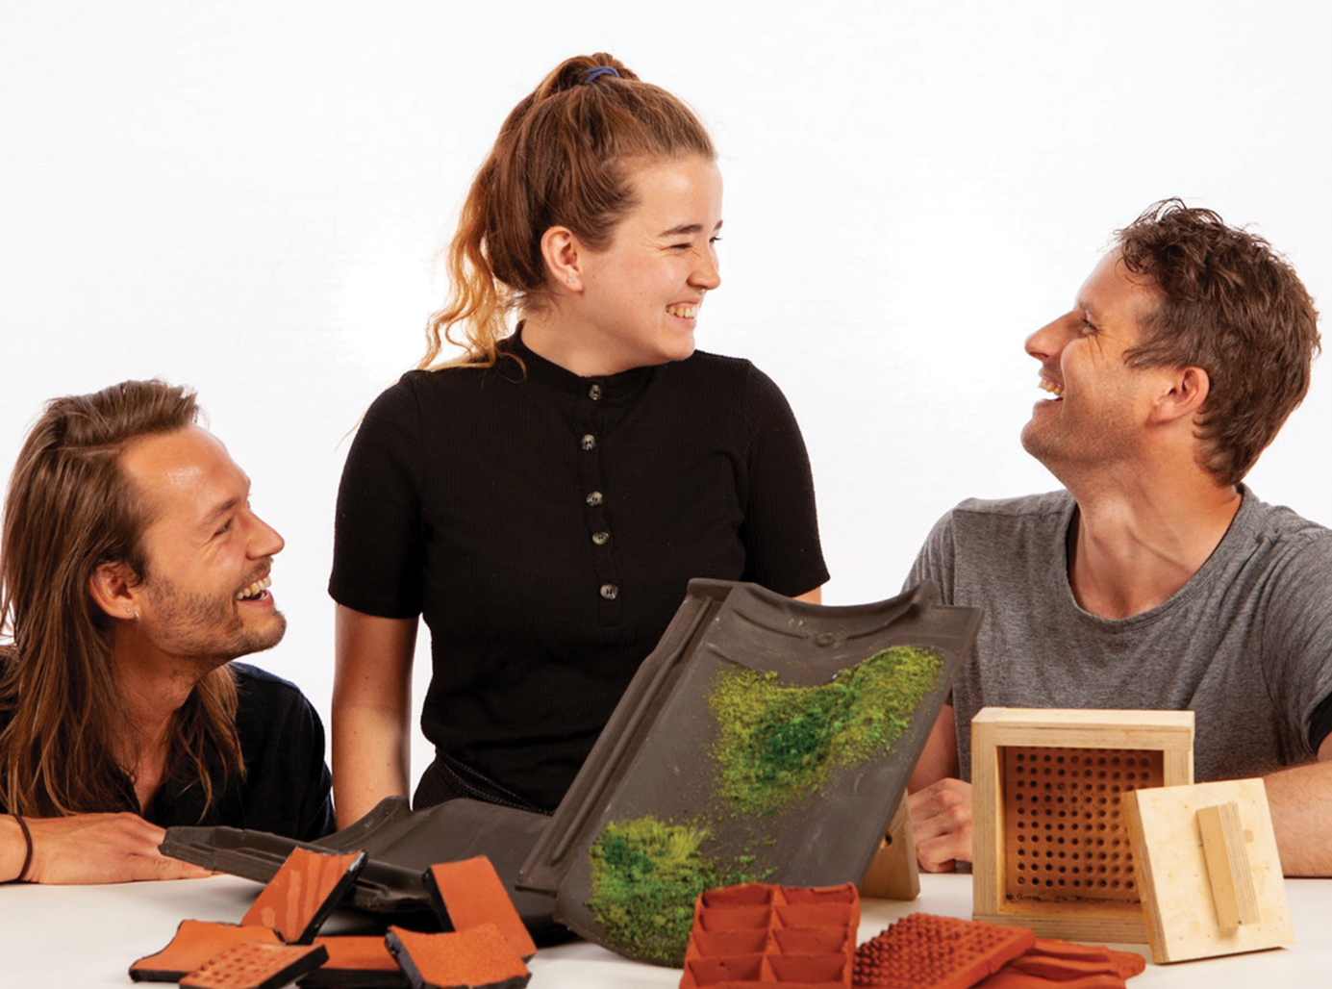
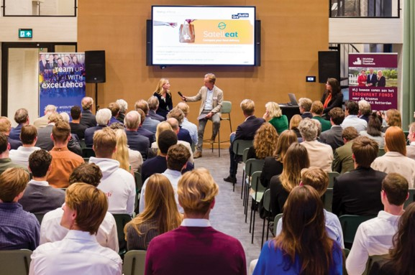
Delft University Fund
Delft University Fund supports TU Delft by contributing to research, education, talent development and entrepreneurship. With donations from alumni, students, foundations and companies, we do everything we can to help talented students and scientists realize their ambitions and achieve societal impact.
We support
Pioneering research with great societal value
Dr. Dimphna Meijer: Nanobrain speeds up brain research
Education programs and scholarships
Justus & Louise van Effen Scholarships and Research Grants
Ambitious students
Funding Ambitious Students TU Delft (FAST)
Entrepreneurship
Graduate Entrepreneur Fund

Slide 31
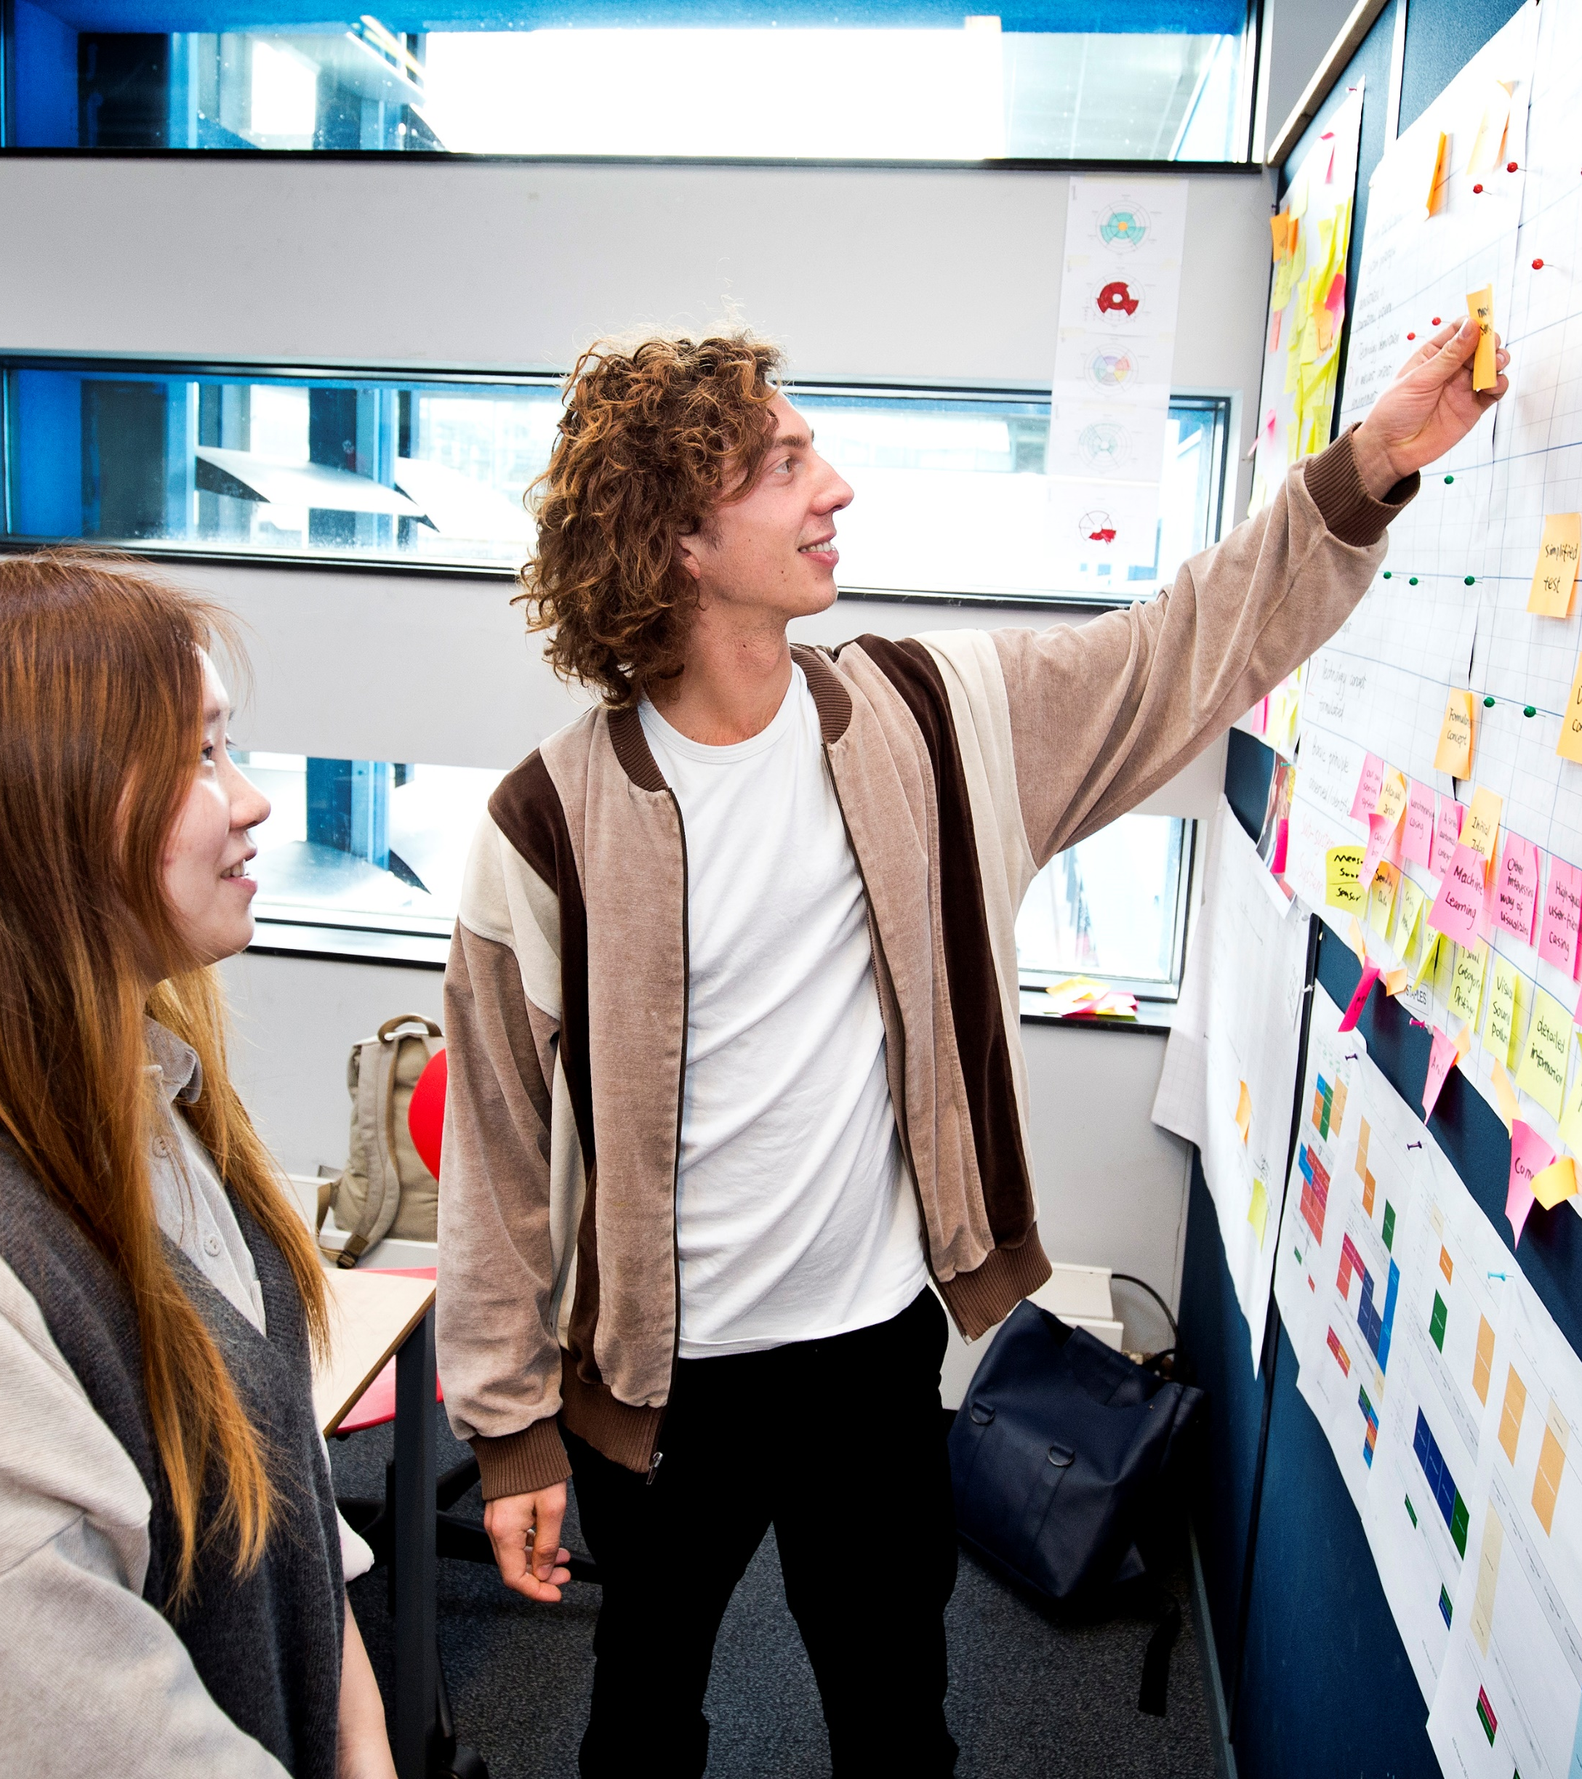
Want to know more on how you can contribute?
Please contact us at ufonds@tudelft.nl or visit www.universiteitsfondsdelft.nl
ANBI-status
Delft University Fund is a foundation with ANBI (organisation serving the public interest)) status. This means that donations made to Delft University Fund may be deductible from taxable income.

Slide 32
Afsluiter
Thank you for your attention

